Slide 1
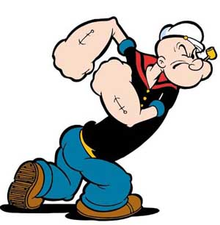
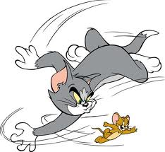
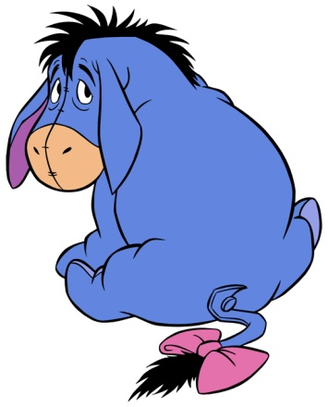
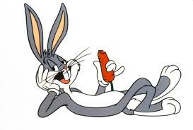
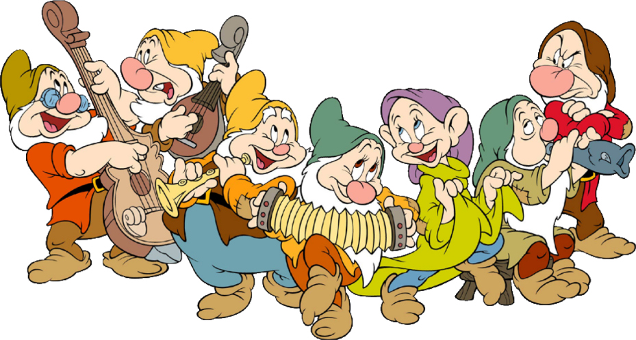
卡通人物，以及…
Source 1
Source 2
Source 3
Source 4
Source 5

Slide 2
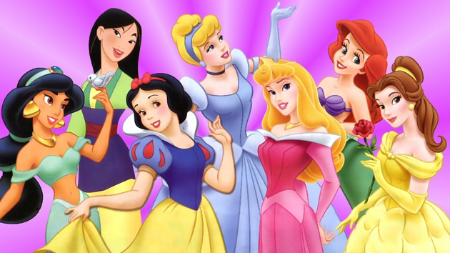
Suggested Questions:
Can you describe some of these Disney female characters’ personality?
What are the common characteristics they share?
Who is your favorite character? Why?
If you have to chose one of these characters, who shares some similar personality with you, who would you choose and why?
Source 6

Slide 3
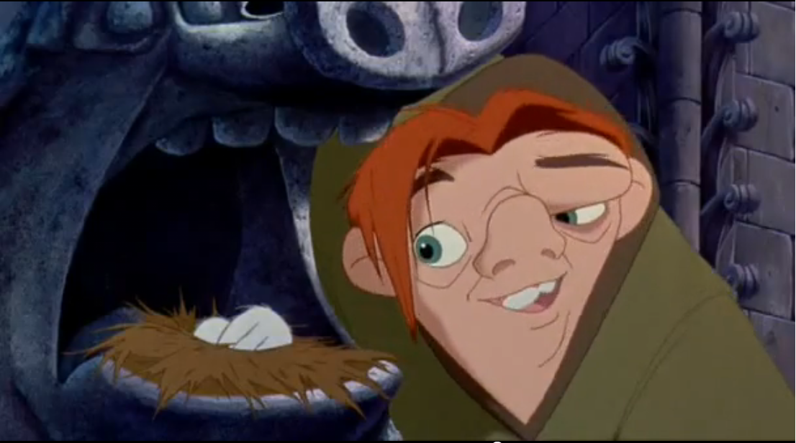
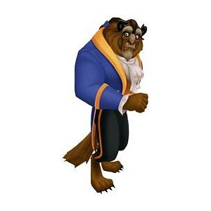
Similar questions as those for the female characters
+
Are all the heroes good looking?
Are there any good looking guys with less desirable traits?
Source 7
How do you describe them?
Are there any good looking guys with less than desirable traits?
Source 8
Source 9

Slide 4
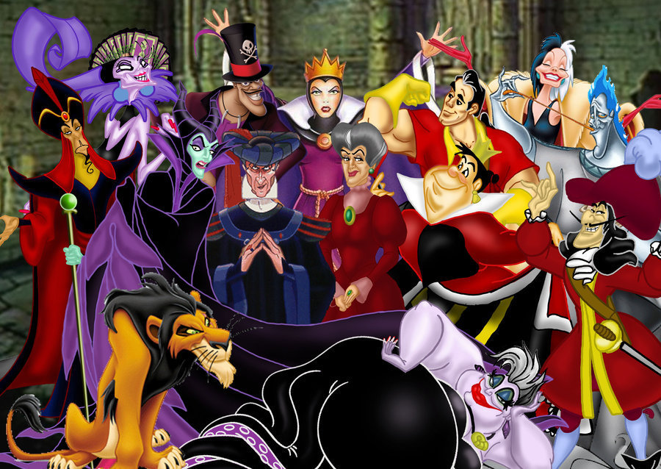
Similar questions
Source 10

Slide 5
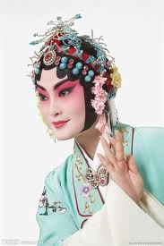
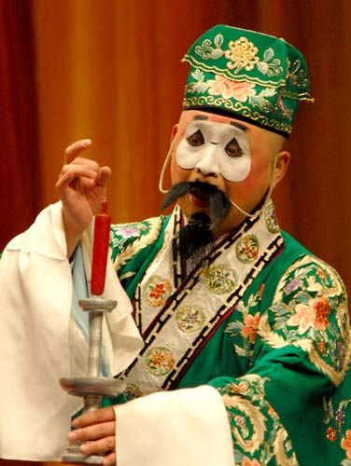
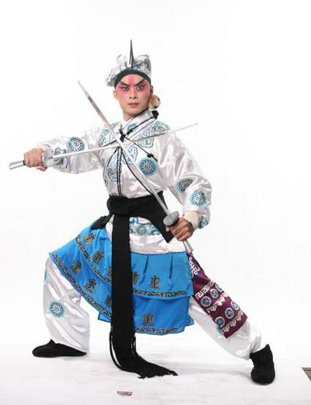
Characters in Beijing Opera 京剧角色
Suggested question:
How do you describe the typical personality of these Beijing opera characters?
Source 13
Source 11
Source 12

Slide 6
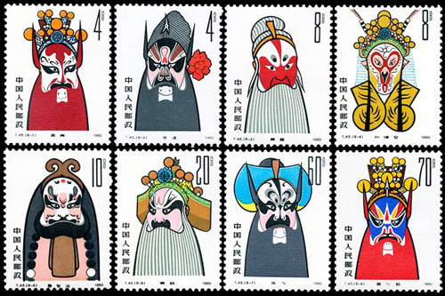
脸谱的颜色代表性格
Suggested question:
What personality traits does each of the colors (red, white, black, blue, and gold) on the face of “Jing” represent?
Suggested activity:
Research the answers online and make a report.
Source 14

Slide 7
Image Sources
www.german.fansshare.com
hdwallpapers-blog.blogspot.com
theimpersonals.com
www.rottentomatoes.com
bronxgadfly.blogspot.com
www.dancelife.com.au
disney.wikia.com
www.thehunchblog.com
www.polyvore.com
pjmedia.com
www.nipic.com
quyi.chinese.cn
quyi.chinese.cn
www.soucang88.com

